Slide 1
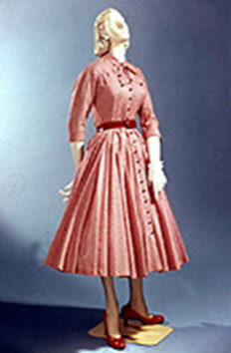
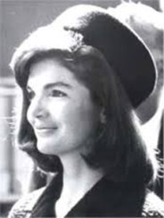
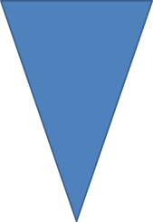
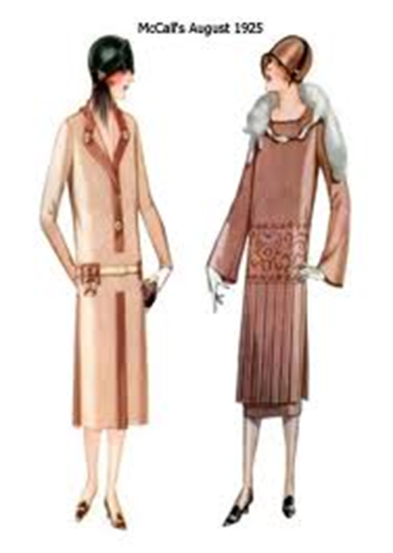
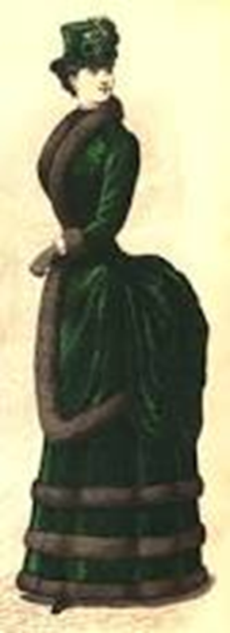
LEVEL 1
Name: ___________________
Q: Name this silhouette : A: | Q: What type of hat is this? A: | Q: Name this silhouette : A: | Q: What type of hat is this? A: | Q: Women who dressed like this in the 1920’s were called_________________ A:
Q: What decade would you see this dress? | Q: What is the name of the clothing making her backside so large? A: | Q: in the 1890 ‘s the American Ideal woman was the ___________ _____________? A: | Q: What is this? A: | Q: Name this silhouette A:
 | Q: What is the name of this silhouette? A: | Q: From 1900’s until now the, major fashion trends have been repeated approximately every ______ to ________ years. A: | Q: In the 1900’s women wore ___________ ______ protect clothing while riding in the new automobile. A: | Q: During the 1900’s the wearing of bloomers was influenced by the invention of the _______________? A:
Q: In the ___________ decade children wore clothing made from flour and sugar sacks. A: | Q: The _______________ jacket was a men’s fashion that became popular in the 1940’s. A: | Q: In the _____________ teenagers began to develop their own fashion styles. A: | Q: In the 1930’s _________ ______ dresses were popular. A: | Q: 1900’s the most popular top for women was the ________________. A:

Slide 2
LEVEL 2
Name: ___________________
Q: What Decade was called the Civil Rights Era? A: | Q: What Decade was called the Dot Com Era? A: | Q: : What Decade was called the Rock N’ Roll Era? A: | Q: : What Decade was called the Yuppie Era? A: | Q: : What Decade was called the Industrial Revolution era? A:
Q: What was the 1st Fashion Capitol? A: | Q: Cristian Dior launched the ________ _________? A: | Q: What 2 Fashion Designers are credited for the fashion looks and direction of the 20th Century? A: | Q: New York Fashion trends are known for being ___________ Cut, _______________ styles. A: | Q: New York Fashions are usually made from _____________ fibers? A:
Q: Loose and unstructured design is associated with which fashion capitol? A: | Q: Elegance and luxurious fabrics are associated with which Fashion Capitol? A: | Q: London is the birthplace of the ________ movement. A: | Q: Young Japanese are favoring the _____________ style. A: | Q: A white button down shirt is an example of _____________ style? A:
Q: Unconventional and startling styles that usually disappear after a few years are called _____________. A: | Q: A temporary or passing fashion. Has great appeal for a short period of time. A: | Q: Coco Chanel’s little black dress is an example of _____________ style? A: | Q: Belt, handbags and shoes are examples of _______________? A: | Q:Necklines, collars, sleeves, hemlines, lapels are examples of _________ ____________. A:

Slide 3
LEVEL 3
Name: ___________________
Q: Another term for color is ____________. A: | Q: Primary colors cannot be broken in component pats. The Primary colors are: ___________, ___________, __________. A: | Q: What type of color is created by combining two Primary colors? A: | Q: ______________ colors are created by combing a Primary and a secondary Color. A: | Q: ____________ line creates a thinner taller silhouette. A:
Q: What type of line is considered graceful and feminine? A: | Q: ______________ line will make a person appear shorter and heavier. A: | Q: ______________ means wrapped or hung on the body and usually held in place with pins, toggles, buttons, sash or belt? A: | Q: _____________ is an item of clothing that satisfies a basic need and continues to be in fashion acceptance over an extended period of time. Timeless. A: | Q: ______________ Clothing mass produced in standard sizes and sold to customers without alterations. A:
Q: Which fashion career decides what a character in a play or movie wears for each scene? A: | Q: Which Fashion career decides what fashion lines and items will be carried in a store? A: | Q: What type of line produces the same illusion as the straight line that it most resembles? A: | Q: Yellow-Green is an example of what type of color? A: | Q: Pink is a ___________ of red. A:
Q: Navy is a ___________ of the color blue. A: | Q: _______________ is a color scheme based on 1 hue. A: | Q: Cool Colors are _________, ___________ and _____________. A: | Q: Warm Colors are __________, ___________, and _____________. A: | Q: ________________ scheme uses opposite colors on the color wheel. A:

Slide 4
LEVEL 4
Name: ___________________
Q: A white shirt, black cardigan and a red scarf is an example of an_________________ color scheme. A: | Q: Purple and Green would be used with Orange to create what type of color scheme? A: | Q: To create a tone add ___________ to a color. A: | Q: What principle of design has to do with the visual division of weight? A: | Q:List the 5 principles of design; A:
Q: _____________ are the tools of design. A: | Q: ______________ are the rules of design. A: | Q: List 6 Manufactured Fibers: A: | Q: List 4 Natural Fibers: A: | Q: _______________ is the fiber that can stretch and is often used in exercise wear. A:
Q: The ___________ weave is the simplest. A: | Q: _____________ weave is the strongest and commonly used in denim. A: | Q: Natural fibers come from _______ and _______. A: | Q: Synthetic fibers or manufactured from _________ _____________. A: | Q: Which fibers, natural or synthetic, are extremely heat sensitive? A:
Q: _____________ is a store that appeals to shoppers looking for a good buy that offers name brands at reduced prices could be seconds? A: | Q: Adding color to a fiber solution before it is extruded is called ____________ dyeing. A: | Q: Yarn Dyeing is when the ____________ are dyed before they are woven or knitted. A: | Q: The process of adding color, pattern or design to the surface of fabrics is called _______________. A: | Q: _____________ is the principle of design that refers to focal point. A:

Slide 5
LEVEL 5
Name: ___________________
Q:____________ is a type of rhythm where lines extend from a central point. A: | Q: A good combination of unity and variety is important to create ________________. A: | Q: The easiest fiber to care for is ______________. A: | Q:Which fiber can be described as: natural, expensive, luxurious and beautiful? A: | Q: Natural Fibers dye darker because they are hydrophilic which means they _________________. A:
Q: The consumer skill of checking an items to see if the stripes and plaids match up is an example of __________ ___________. A: | Q: The value of a garment is determined by __________________. A: | Q: School Uniforms are an example of ______________. A: | Q: Charlie tries on a shirt that doesn’t fit well, but his friend convinces him to buy it. This is known as _______________ consumer influence. A: | Q: Ad campaigns and professional athlete /famous spokes model endorsements are example of what consumer influence. A:
Q: Macy’s is an example of_______________ type of store. That offers large varieties of many types of merchandise placed in appropriate departments. A: | Q: _____________ __________ are optional on a garment but they list the brand name, logo, & advertising. A: | Q: Labels on garments are required to list: _____________ content _____________ care _____________ number _____________ of origin A: | Q: Working at a store in the mall is an example of _____________ sales in the fashion industry. A: | Q: A _____________ is the currently accepted, prevailing style. A:
Q:Popular trends in the 1960 were fashioned after which 1st Lady. A: | Q: __________ _________ was the country that had a major influence on fashion in the 1960’s. A: | Q: ______________ was a very popular fiber in the 1970’s. A: | Q: What decade is the Hippy to Disco Era? A: | Q: The A-Line dress is an example of a ___________ silhouette. A:

Slide 6
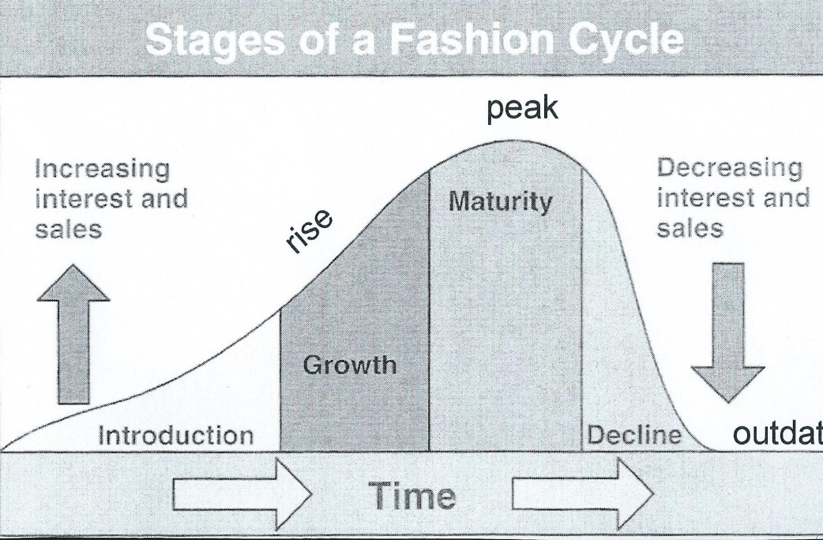
LEVEL 6
Name: ___________________
Silhouettes | Decade it was popular | Draw an example
 | 1890, 1930, 1950
tubular
 | 1900 | S
 | 1970
Label the
Stages of Fashion

